Slide 1



From Legacy MVC to Modern MVC An ASP.NET Core Migration Path
@Scott_Addie

Slide 2
Agenda
Upgrade Paths
Assembly Portability
Dependency Injection
App Settings
Package Management
Bundling & Minification

Slide 3


You Are Here
ASP.NET 4.6
.NET Framework 4.6
Operating Systems
Editors VS 2015
Web Server IIS
Distribution OS
Notes:
ASP.NET introduced in 2002
Best candidate for ASP.NET Core = MVC or Web API

Slide 4


Determine Your Upgrade Path
ASP.NET Core 1.1
.NET Framework 4.6.2
.NET Core 1.1
net462
netcoreapp1.1
Operating Systems
Operating Systems
Editors VS 2015+, VS Code*
Editors VS 2015+, VS Code VS Code
Web Server IIS, Kestrel
Web Server IIS, Kestrel, HttpSys Nginx, Kestrel
Distribution OS
Distribution w/ or w/o App
* Debugging not currently supported
Notes:
.NET Core App Deployment Options
Framework-dependent
Self-contained
IIS reverse proxies HTTP to Kestrel
Kestrel doesn’t provide port 80/443 forwarding
Treat Kestrel just as your app server; not yet blessed as public-facing edge server
.NET Core not really a subset; has its own unique APIs & tooling
.NET Standard Library has become new Base Class Library (BCL)
Popular APIs missing in .NET Core:
System.DirectoryServices
No LDAP / AD support
System.Drawing

Slide 5
The Value Proposition of .NET Core
X-plat
Open source
Everything is a dependency (cafeteria plan)
Broader container support
Cloud-optimized
Notes:
Containers
No machine-wide installation
App isolated from machine-level patches

Slide 6
Assembly Portability

Slide 7
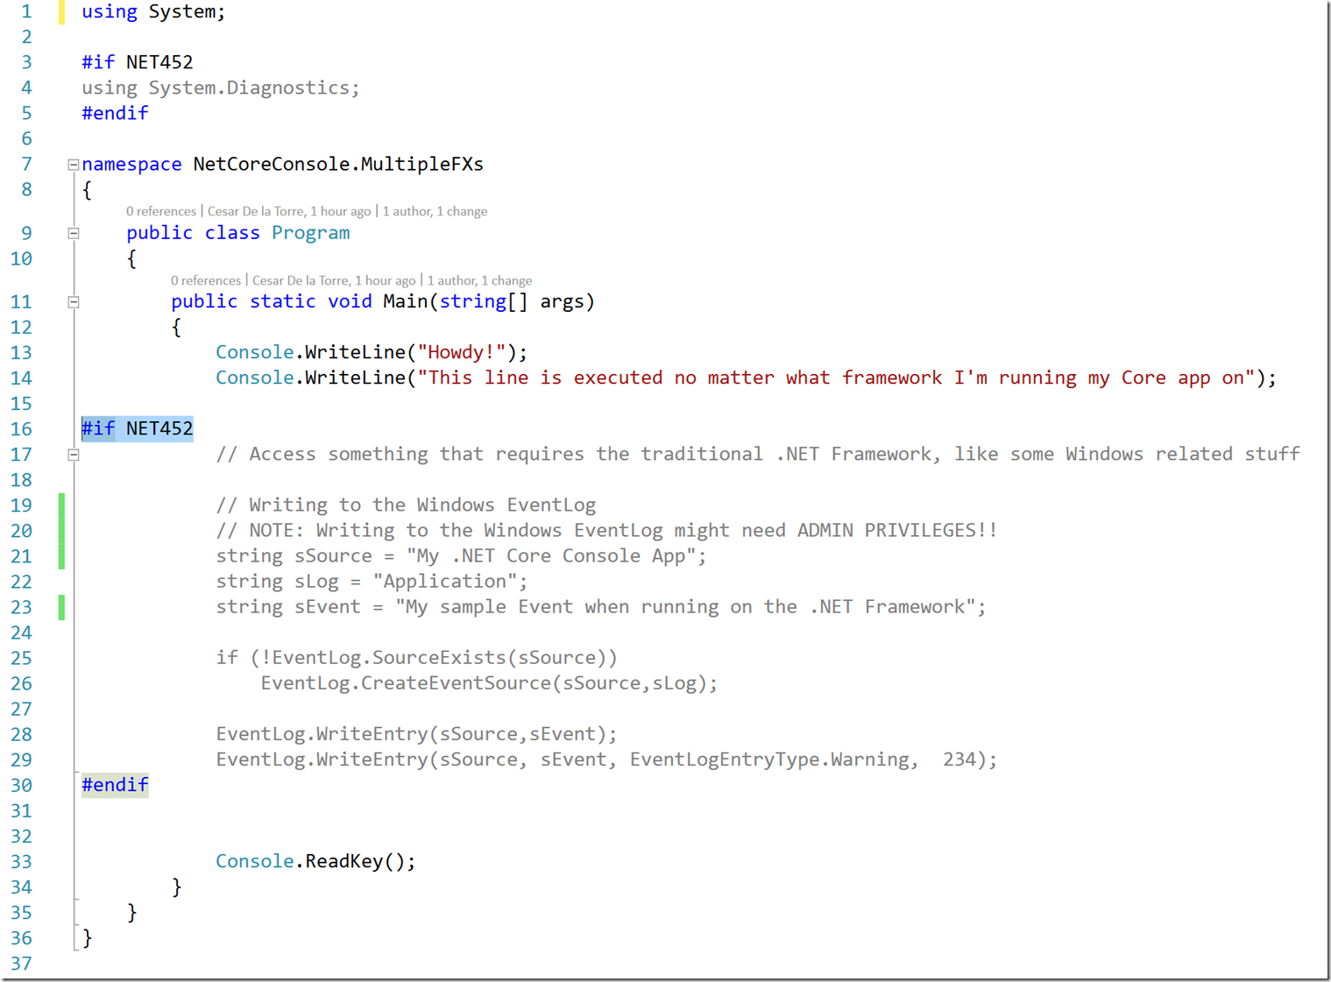
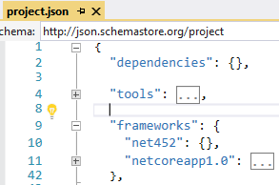
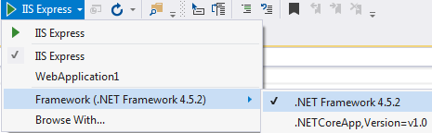
Precompiler Directives

Slide 8
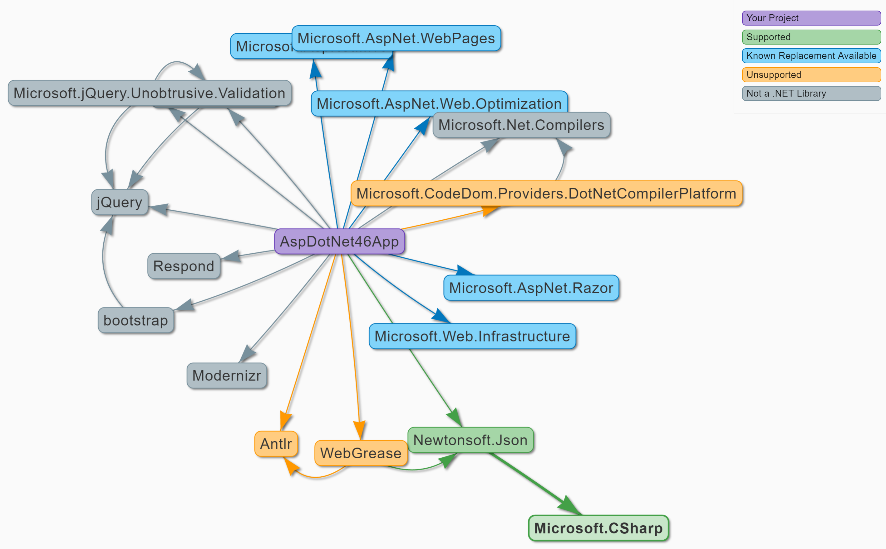
Portability Analyzers I Can Has .NET Core (https://icanhasdot.net/)
Notes:
VS 2017 CSPROJ projects NOT supported
NuGet & Paket supported

Slide 9
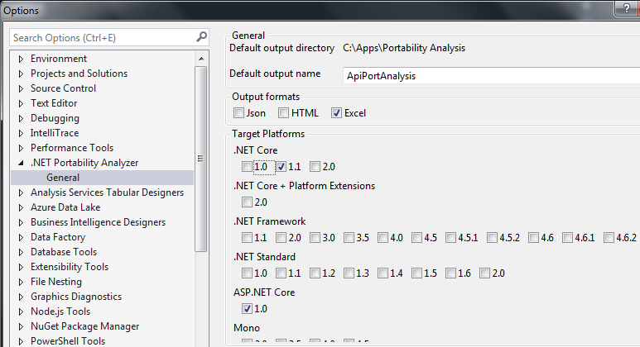
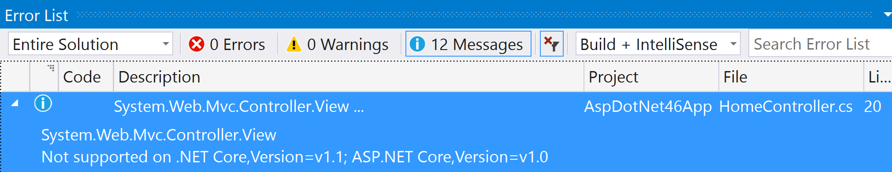
Portability Analyzers .NET Portability Analyzer (http://bit.ly/2llzOPS)
Notes:
Target .NET Framework 4.6.1+ as long as possible before switching to .NET Core
- Missing APIs available in .NET 4.6.1

Slide 10

.NET Portability Analyzer 3 Options
.NET Portability Analyzer
Console Application
Visual Studio Extension
.NET Core Application
Notes:
Extension only supported in VS 2015

Slide 11




.NET Portability Analyzer How It Works
Assemblies
Assemblies
ApiPort VS Extension
Portability Service
Notes:
Target .NET 4.6.1+ as long as possible before switching to .NET Core
- Missing APIs available in .NET 4.6.1

Slide 12
Dependency Injection

Slide 13
Native IoC Container Constructor Injection
Startup.cs
public void ConfigureServices(IServiceCollection sc) { sc.AddTransient<IAttendeeService, AttendeeService>(); // Add framework services. sc.AddMvc(); }
AttendeesController.cs
public class AttendeesController : Controller { private readonly IAttendeeService _attendeeSvc; public AttendeesController( IAttendeeService attendeeSvc) { _attendeeSvc = attendeeSvc; }

Slide 14
Autofac Constructor Injection
AutofacModule.cs
public class AutofacModule : Module { protected override void Load(ContainerBuilder cb) { cb.RegisterType<AttendeeService>() .As<IAttendeeService>(); } }
Startup.cs
public IServiceProvider ConfigureServices(IServiceCollection sc) { // Add framework services. sc.AddMvc(); var containerBuilder = new ContainerBuilder(); containerBuilder.RegisterModule<AutofacModule>(); containerBuilder.Populate(sc); var container = containerBuilder.Build(); return container.Resolve<IServiceProvider>(); }
AttendeesController.cs
public class AttendeesController : Controller { private readonly IAttendeeService _attendeeSvc; public AttendeesController( IAttendeeService attendeeSvc) { _attendeeSvc = attendeeSvc; }

Slide 15
3rd Party DI Frameworks
More feature rich
Extensible lifetimes (per thread, per resolve cycle, etc.)
Auto wiring of types in assembly
Resolve Lazy<T> instances of registered types
Recommendation:
Native IoC for greenfield development
3rd party IoC to migrate existing investment

Slide 16
App Settings

Slide 17
XML is Abandoned for JSON
web.config
appsettings.json
<configuration> <appSettings> <add key="webpages:Version" value="3.0.0.0" /> <add key="webpages:Enabled" value="false" /> <add key="ClientValidationEnabled" value="true" /> <add key="UnobtrusiveJavaScriptEnabled" value="true" /> <add key="AttendeeInfo:FirstName" value="Scott" /> <add key="AttendeeInfo:LastName" value="Addie" /> <add key="AttendeeInfo:IsSpeaker" value="true" /> </appSettings>
{ "Logging": { "IncludeScopes": false, "LogLevel": { "Default": "Debug", "System": "Information", "Microsoft": "Information" } }, "AttendeeInfo": { "FirstName": "Scott", "LastName": "Addie", "IsSpeaker": true } }

Slide 18
Retrieving App Settings Strongly-typed IOptions<T>
Startup.cs
public void ConfigureServices( IServiceCollection sc) { sc.AddOptions(); sc.Configure<Attendee>(Configuration .GetSection("AttendeeInfo")); }
appsettings.json
Attendee.cs
{ "AttendeeInfo": { "FirstName": "Scott", "LastName": "Addie", "IsSpeaker": true } }
public class Attendee { public string FirstName {get; set;} public string LastName {get; set;} public bool IsSpeaker {get; set;} }
AttendeesController.cs
Map
public class AttendeesController : Controller { private readonly Attendee _attendee; public AttendeesController( IOptions<Attendee> attendee) { _attendee = attendee.Value; }
Inject
AttendeesController.cs
var firstName = _attendee.FirstName;
Retrieve

Slide 19
Retrieving App Settings IConfiguration.GetValue
Startup.cs
public void ConfigureServices( IServiceCollection sc) { sc.AddSingleton<IConfiguration>( Configuration); }
appsettings.json
AttendeesController.cs
{ "AttendeeInfo": { "FirstName": "Scott", "LastName": "Addie", "IsSpeaker": true } }
public class AttendeesController : Controller { private readonly IConfiguration _config; public AttendeesController( IConfiguration config) { _config = config; }
Inject
Retrieve
AttendeesController.cs
var firstName = _config.GetValue<string>( "AttendeeInfo:FirstName");

Slide 20
Package Management

Slide 21
NuGet Changes
packages.config is dead
VS 2015 Update 1+ ← project.json
VS 2017 ← *.csproj w/ <PackageReference />
OLD NEW
<.sln_folder>\packages %USERPROFILE%\.nuget\packages
Notes:
- repositories.config goes away

Slide 22
NuGet Centralized Packages Repository
NuGet Cache
ASP.NET Core App
ASP.NET Core App
ASP.NET Core App
Microsoft.AspNetCore.Mvc
Microsoft.EntityFrameworkCore
Newtonsoft.Json
Notes:
Assume this is the CI server
Per user package cache (service account runs builds)

Slide 23
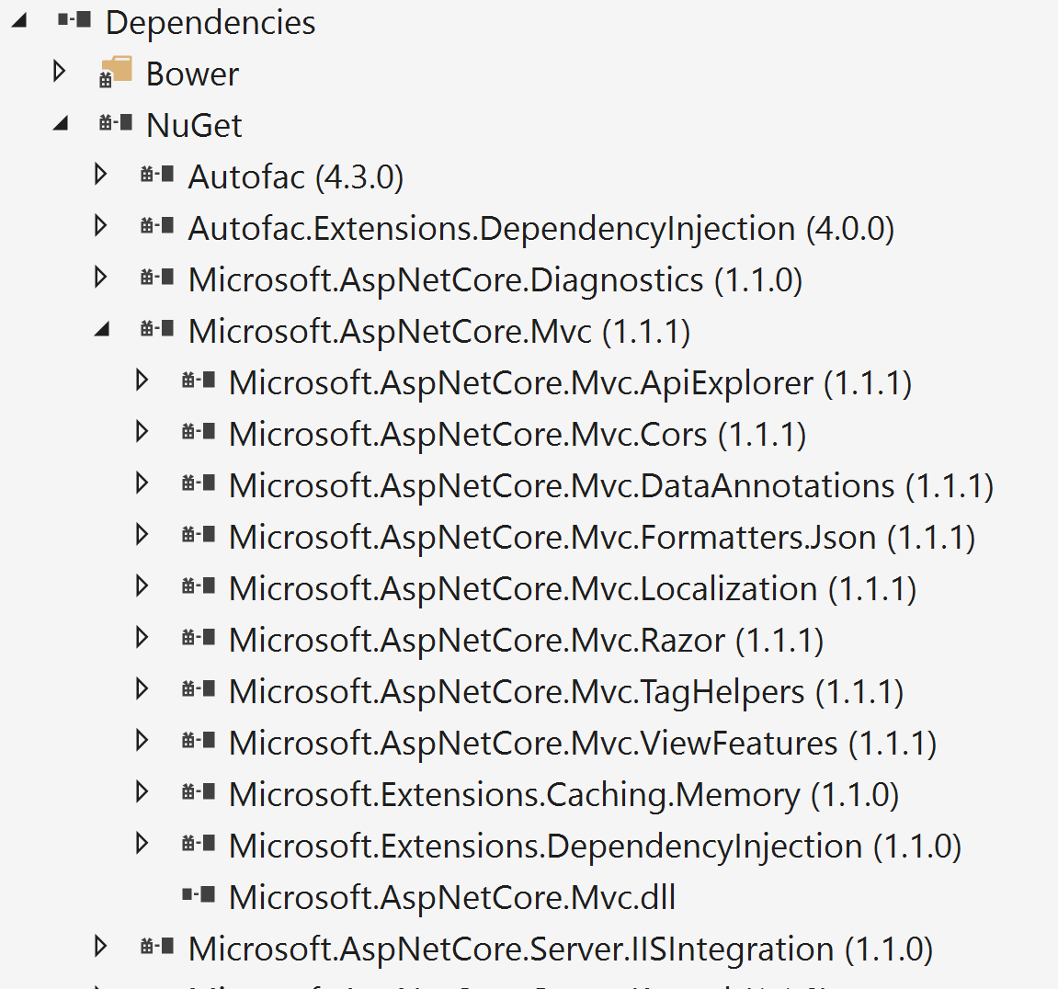
NuGet Transitive References
<project_name>.csproj
<ItemGroup> <PackageReference Include="Microsoft.AspNetCore.Mvc" Version="1.1.1" />

Slide 24


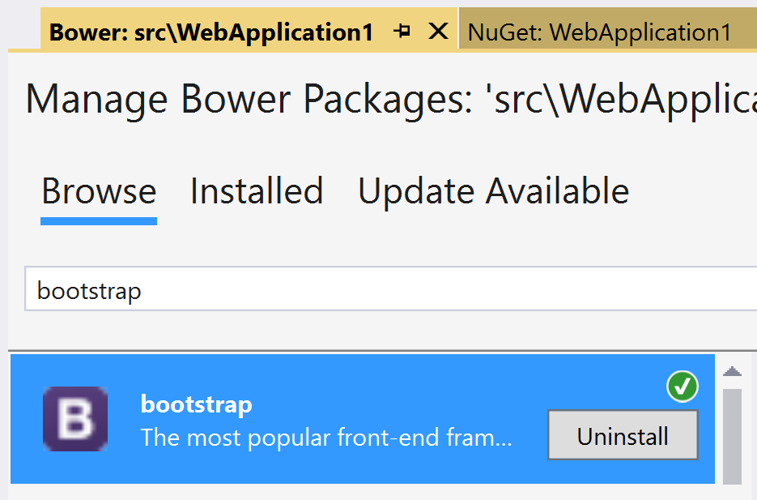
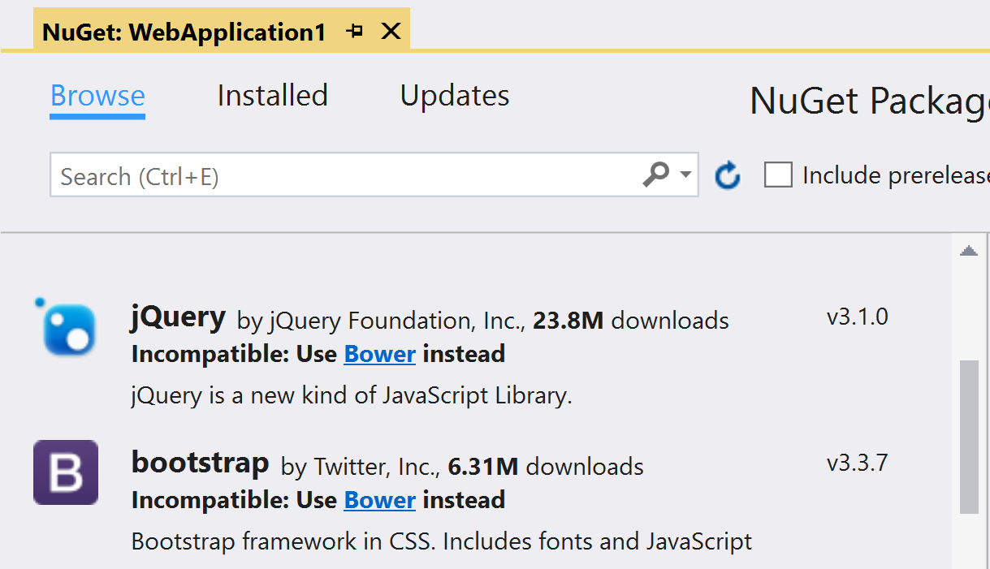
Bower Static Asset Acquisition
Manage NuGet Packages
Manage Bower Packages
Notes:
- Content files not supported in ASP.NET Core projects

Slide 25
Bundling & Minification

Slide 26
A Look at Where We’ve Been
Microsoft.AspNet.Web.Optimization
Grunt
Gulp
ASP.NET 4.5
NuGet
C# or VB.NET
On-the-fly processing by web server
ASP.NET 5 Beta
npm
JavaScript
Process before deploying
ASP.NET Core 1.0 RC
npm
JavaScript
Process before deploying

Slide 27

The Way Forward
bundleconfig.json
[ { "outputFileName": "wwwroot/css/site.min.css", "inputFiles": [ "wwwroot/css/site.css" ] }, { "outputFileName": "wwwroot/js/site.min.js", "inputFiles": [ "wwwroot/js/site.js" ], "minify": { "enabled": true, "renameLocals": true }, "sourceMap": false } ]
BundlerMinifier.Core
ASP.NET Core 1.0 RTM
NuGet
JSON
Process before deploying
Notes:
Bundler & Minifier added to Preview 2 Tooling
Uses a .NET Core port of AjaxMin for minification, called NUglify

Slide 28
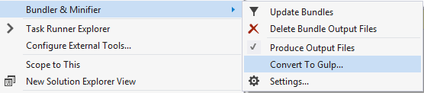
…but Gulp still has its place
Bundler & Minifier extension
Reserve for complex workflows
Notes:
Reasons for Gulp Replacement:
Publishing was taking a long time w/ Gulp & npm
npm had to install all of its packages
There were already enough new concepts in ASP.NET Core
Many customers don’t like having node_modules in their project
~1,500 files in node_modules folder
File ➔ New ➔ Project was quicker w/o npm

Slide 29

A Supplementary Resource
Telerik Developer Network article
Migration to ASP.NET Core: Considerations and Strategies
http://bit.ly/2lHxgyb

Slide 30





Thank you!
@Scott_Addie
scottaddie.com
github.com/scottaddie
/DotNetCoreSampleApp
/slide-decks

